Slide 1
PLANET PIZZA
Project based on MY-SQL

Slide 2
CONTENTS
Q1. Retrieve the total number of orders placed.
Q2. Calculate the total revenue generated from pizza sales.
Q3. Identify the highest-priced pizza.
Q4. Identify the most common pizza size ordered.
Q5. List the top 5 most ordered pizza types along with their quantities.
Q6. Join the necessary tables to find the total quantity of each pizza category ordered.
Q7. Determine the distribution of orders by hour of the day.
Q8. Determine the top 3 most ordered pizza types based on revenue

Slide 3
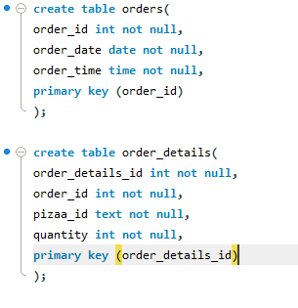
Creating Tables

Slide 4
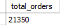
01
Retrieve the total number of orders placed.
RESULT

Slide 5
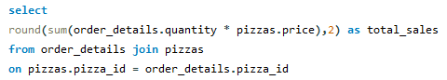
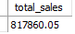
02
Calculate the total revenue generated from pizza sales
RESULT

Slide 6
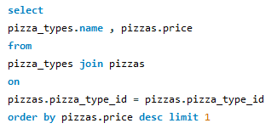
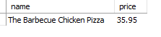
03
Identify the highest-priced pizza.
RESULT

Slide 7
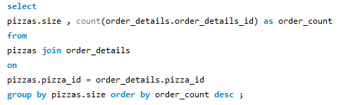
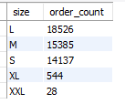
04
Identify the most common pizza size ordered.
RESULT

Slide 8
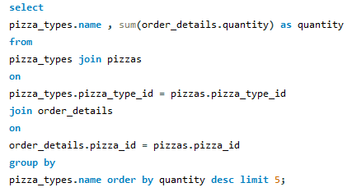
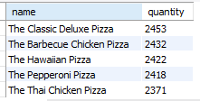
05
List the top 5 most ordered pizza types along with their quantities.
RESULT

Slide 9
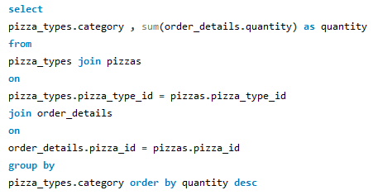
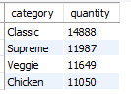
06
Join the necessary tables to find the total quantity of each pizza category ordered.
RESULT

Slide 10
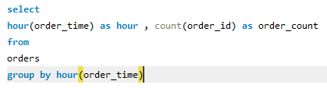
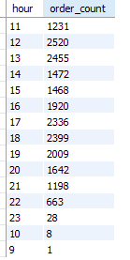
07
Determine the distribution of orders by hour of the day.
RESULT

Slide 11
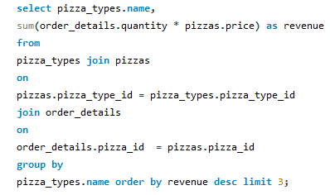
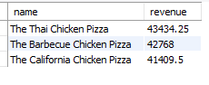
08
Determine the distribution of orders by hour of the day.
RESULT

Slide 12
Planet Pizza
So ,in this project we have completed all of the questions well.
The work-bench which i used is MY_SQL.
I have utilize SQL-Quries to solve question that were related to pizza sales

Slide 13
THANK YOU

